Slide 1
ANJUMAN COLLEGE OF ENGINEERING & TECHNOLOGY
MATHEMATICS DEPARTMENT
PREPARED BY
Prof. FARHA YASMEEN

Slide 2
APPLIED MATHEMATICS -III
UNIT -4 PARTIAL DIFFRENTIAL EQUATION

Slide 3
INTRODUCTION:
An equation involving partial derivatives of a function of two or more independent variables is called as Partial Differential Equation.
The equation is called as Linear Partial Differential equation, if it is of first degree in the dependent variable and its partial derivatives, otherwise it is called as Non-Linear(The partial derivatives not of first order).

Slide 4
Solution of lagrange’s form: Pp + Qq = R
The general solution of Lagrange’s linear partial differential equation Pp +Qq =R is ɸ (u,v) =0 , where ɸ is an arbitrary function and u(x,y,z)=a and v(x,y,z)=b (a and b are arbitrary constants) , are the solutions of the equations ------------(1)
Equation (1) are called as Lagrange’s auxiliary equation.

Slide 5
Methods of solving lagrange ‘s auxiliay equatioNs:
=
where P , Q and R are the function of x,y and z.
(I) METHOD OF GROUPING :

Slide 6
Question: Solve
Solution: Given,
Standard form of given equation is
Compare with Pp+Qq =R and A.E. equation is
Here P = y Q = -x and R =
Therefore
Consider
therefore
Integrating , we get

Slide 7
Now considering
(since )
Or
on integrating , we get
From equation (2) and (3), the solution of equation (1) is
Hence solved.

Slide 8
Example 2: Solve
Solution: Given
A.E is
Taking
Therefore
Intagrating, we get
or

Slide 9
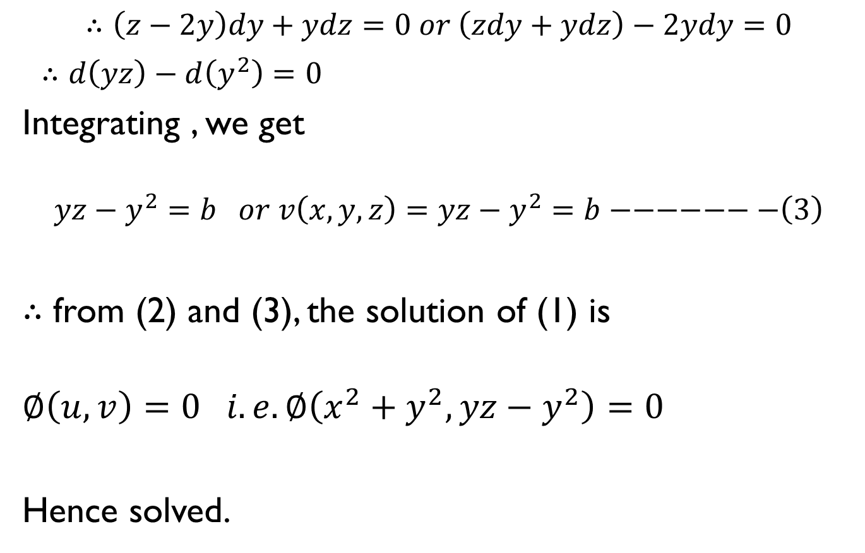
Now consider $\frac{dy}{−xy}=\frac{dz}{x(z−2y)}$
$$∴\left(z−2y\right)dy+ydz=0 or \left(zdy+ydz\right)−2ydy=0$$
$∴d\left(yz\right)−d\left(y^{2}\right)=0$
Integrating , we get
$$yz−y^{2}=b or v\left(x,y,z\right)=yz−y^{2}=b−−−−−−−\left(3\right)$$
$∴$ from (2) and (3), the solution of (1) is
$$∅\left(u,v\right)=0 i.e. ∅\left(x^{2}+y^{2},yz−y^{2}\right)=0$$
Hence solved.

Slide 10
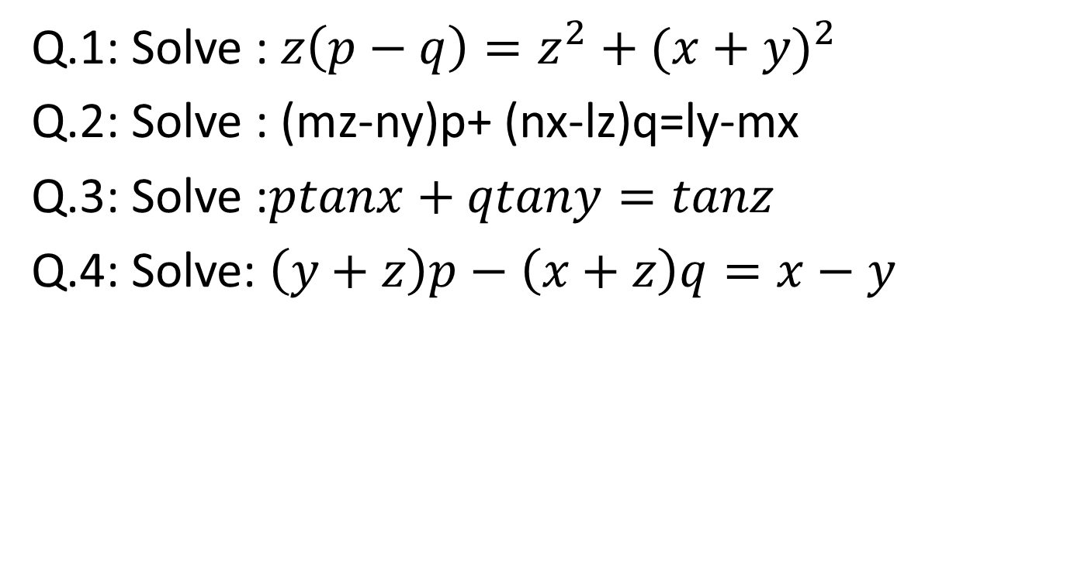
Question for practice
Q.1: Solve : $z\left(p−q\right)=z^{2}+{(x+y)}^{2}$
Q.2: Solve : (mz-ny)p+ (nx-lz)q=ly-mx
Q.3: Solve :$ptanx+qtany=tanz$
Q.4: Solve: $\left(y+z\right)p−\left(x+z\right)q=x−y$

Slide 11
THANK YOU

